Slide 1
Software Construction
Working Effectively with Legacy Code

Slide 2
Introduction
“Legacy Code is code without tests”
Or
“Piece of code which is maintained by other person rather than its original author”
Notes:
When there’s a thread about Legacy Code, this book is recommended. But what are the key points of that book?
We will discuss of the salient points of the book and how they can help you deal with your existing codebase.

Slide 3
First, add tests, then do your changes
The challenge with changing existing code is to preserve the existing behavior.
When code is not tested, how do you know you didn’t break anything?
You need feedback. Automated feedback is the best. Thus, this is the first thing you need to do: write the tests.
Only then you’ll be safe to change the code and refactor.
Your goal is to get there.
Refactoring
Notes:
The point of the book is to show you how you can get there when you have to deal with an impossibly convoluted codebase. Which leads us to the next point.

Slide 4

Adding tests: the Legacy Code dilemma
Before you change code, you should have tests in place. But to put tests in place, you have to change code.
This is the inconsistency of Legacy Code!
So, how do you go about it? Are you doomed?
You’re not. But you should be extra careful until you got tests in place. You should perform minimal, safe refactoring.

Slide 5

Cont…
Change as little code as possible to get tests in place.
The recipe is:
Identify change points (Seams)
Break dependencies
Write the tests
Make your changes
Refactor
Once you get to the tests, you know how to proceed. The first two points are the difficult ones.

Slide 6
Identify Seams to break your code dependencies
Adding tests on the existing code can be challenging, a nightmare!
That’s because the code was not written to be testable in the first place. 99% of the time, this is a dependency problem: the code you want to test can’t run because it needs something to put in the test.
Sometimes it’s a database connection. Sometimes it’s a call to a third-party server. Sometimes it’s a parameter that’s complex to instantiate. Usually, it’s a complex mix of all that.
To test your code, you need to break these dependencies in the tests.
Therefore, you need to identify Seams.
“A Seam is a place of code to alter program behavior, without changing the code.”

Slide 7
Use Sprout & Wrap techniques to add code when you don’t have time to refactor
Big lumps of code have a gravitational force. They attract more code.
It’s the Broken Window theory: a little disorder calls for more serious crimes. If the class is already 2,000 lines-long, who cares that you add 3 more if statements.
Well, you should. Now you have to maintain a 2,010 lines-long class!
But what if you really, really don’t have time to write tests for that class? That’s just 3 if statements and you might not feel like you can justify taking 2 days for that — although you should. In such a tricky position, you can still make the right call with these 2 techniques:
The sprout technique
The wrap technique

Slide 8
The Sprout Technique
Sprout Technique:
Definition: Sprouting involves adding new functionality by creating new subclasses or derived classes that inherit from existing classes.
Focus: It emphasizes extending functionality by adding new methods or attributes to the derived classes.
Use Case: Commonly used when the core functionality of existing classes needs extension without altering their original behavior.

Slide 9

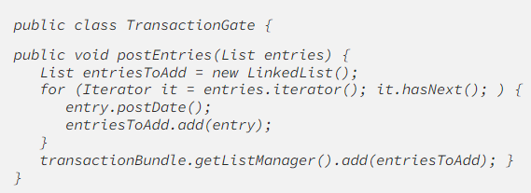
The Sprout Technique
Create your code somewhere else.
Unit test it.
Identify where you should call that code from the existing code: the insertion point.
Call your code from the Legacy Code.
Consider the following example:

Slide 10
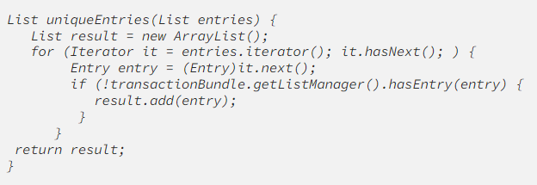
Cont…
Say you need to deduplicate the entries, but postEntries() is hard to test and you really don’t have time for that.
You can sprout the code somewhere else, like in a new method uniqueEntries().
This new method, you can test easily, because it’s isolated.
Then, insert a call to that method in the existing, non-tested code. Minimal change, minimal risk.

Slide 11
The Wrap Technique
Definition: Wrapping involves creating wrapper classes that contain instances of existing classes and add new functionality without modifying the existing classes.
Focus: It emphasizes adding new functionality by creating wrapper classes around existing classes, often using composition.
Use Case: Suitable when modifying existing classes directly is not feasible or when there's a need for additional functionalities without changing the original classes.

Slide 12

The Wrap Technique
When the change you need to do should happen before or after the existing code, you can also wrap it.
Rename the old method you want to wrap.
Create a new method with the same name and signature as the old method.
Call the old method from the new method.
Put the new logic before/after the other method call.
That new logic, you can test.
Why? Because the old method is a Seam you can alter in the tests.

Slide 13
Differentiation using an OOP Language (Java):
Sprout Technique in Java: Involves creating subclasses to add functionality. For instance, extending a Vehicle superclass with a Car subclass to include specific car-related methods or attributes.
Wrap Technique in Java: Involves creating wrapper classes around existing classes to add functionalities through composition.

Slide 14
Parallel Programming:
Definition: Parallel programming involves the simultaneous execution of multiple tasks or processes to enhance performance by utilizing multiple cores or processors.
Focus: It emphasizes breaking down a task into smaller, independent parts that can be executed simultaneously.
Concurrency Handling: Tasks are executed concurrently, with the goal of completing them more quickly.
Use Case: Commonly used in computationally intensive tasks or operations that can be divided into independent parts (e.g., matrix multiplication).

Slide 15
Concurrent Programming:
Definition: Concurrent programming focuses on managing multiple tasks that can start, run, and complete in overlapping time periods.
Focus: It emphasizes the effective handling of multiple tasks that may execute at the same time, possibly sharing resources.
Concurrency Handling: Involves the coordination of tasks to ensure they don't interfere with each other and access shared resources safely.
Use Case: Useful for applications that involve handling multiple user requests, such as web servers or database management systems.

Slide 16
Differentiation using an OOP Language (Java):
Parallel Programming in Java: Utilizes constructs like Java's ExecutorService and ForkJoinPool to execute tasks concurrently across multiple processors or threads.
Concurrent Programming in Java: Involves synchronization mechanisms like synchronized blocks or classes and java.util.concurrent classes to manage concurrent access to shared resources.

